Slide 1
Re-assembly of Thermo Delta V Source

Slide 2
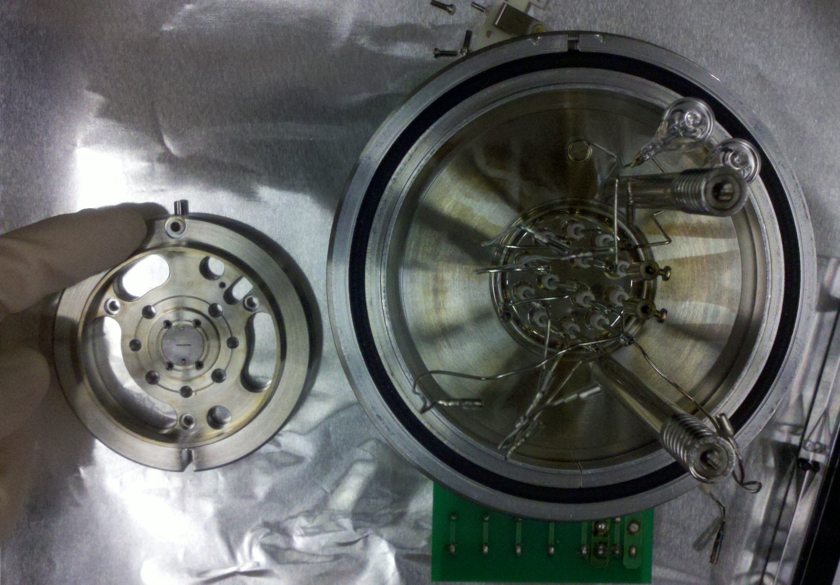
Orient primary exit slit in housing with inlet hole at top and mounting notch at bottom of main source

Slide 3
Put on main exit slit and retention plate

Slide 4
X-deflection plates
Ceramic posts
Feedthroughs
Quadrupole
Y-deflection plates
Ceramics Identification

Slide 5
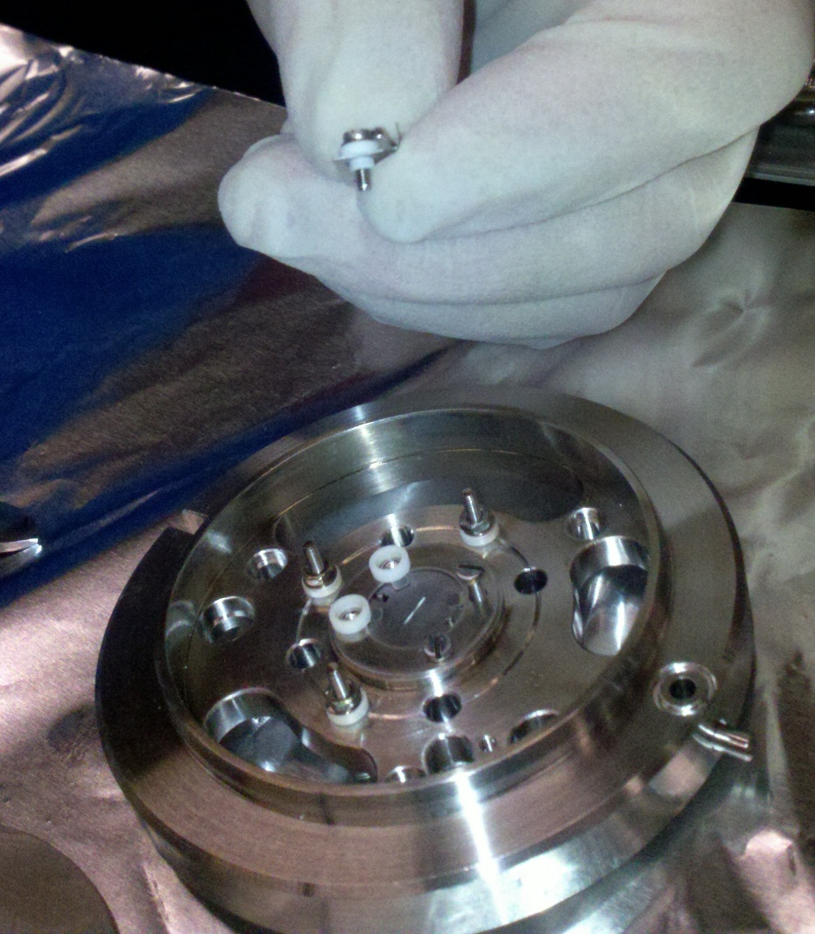
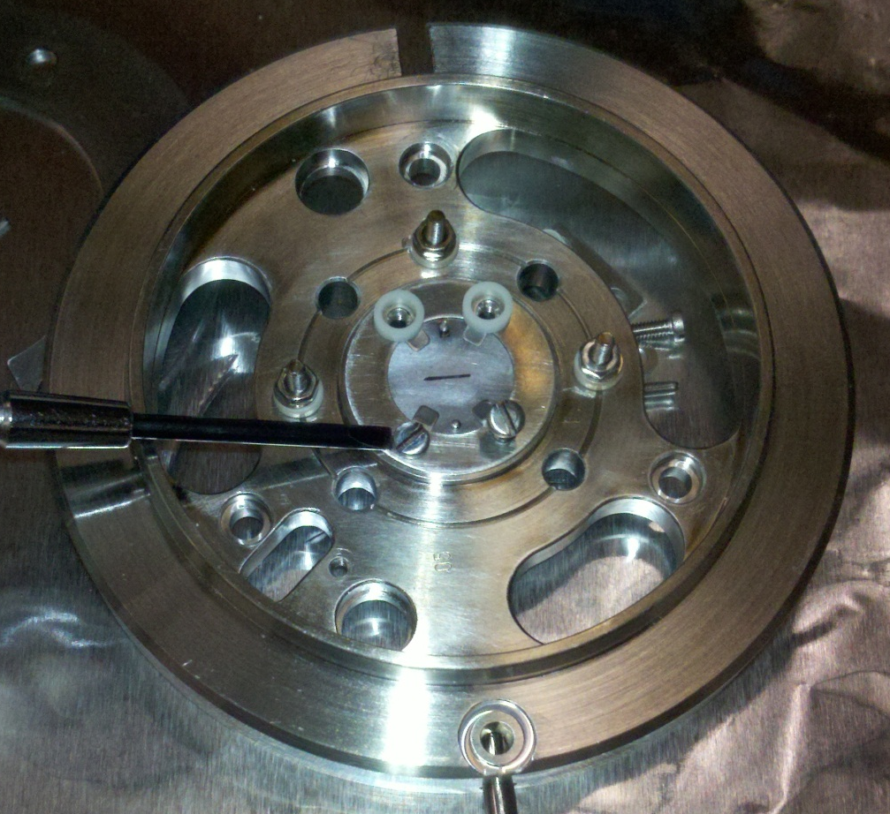
Temporarily screw down main slit retention plate
Place 2 x-deflection ceramics over holes where x-deflection plate will be placed
Prepare X-deflection plate screws
Screw
Washer
Ceramic feedthrough
X-deflection plate
Place over small ceramics – screw in

Slide 6
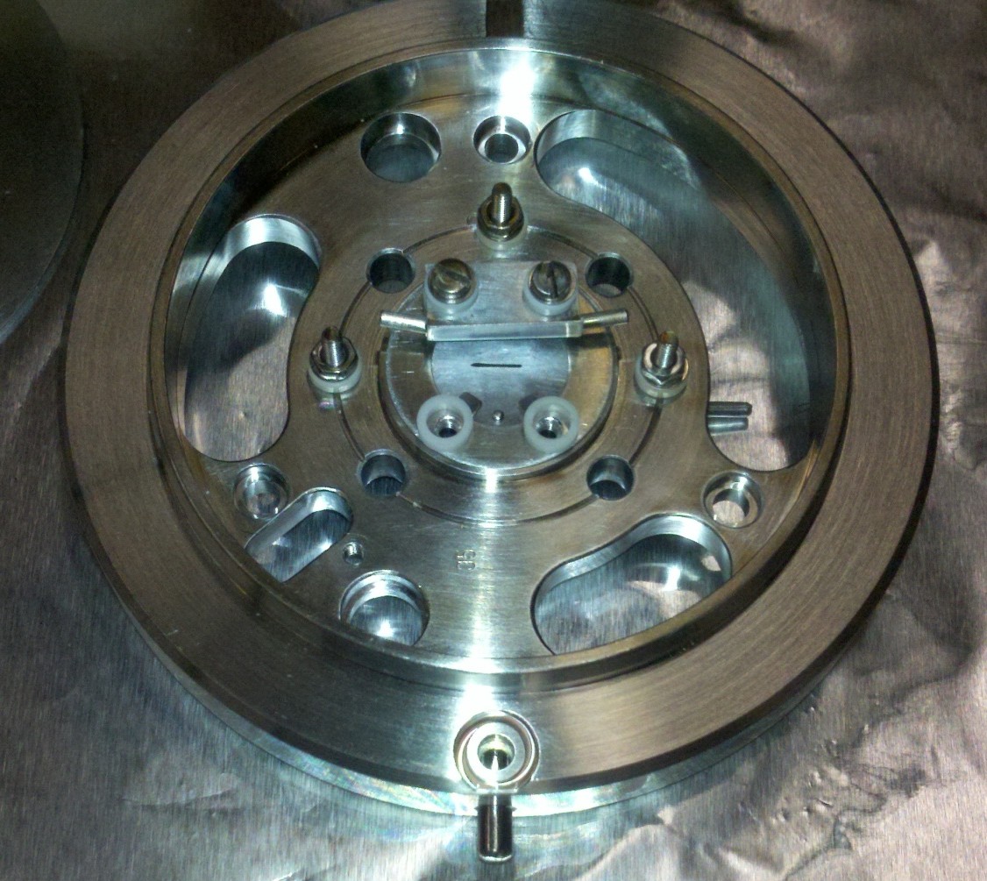
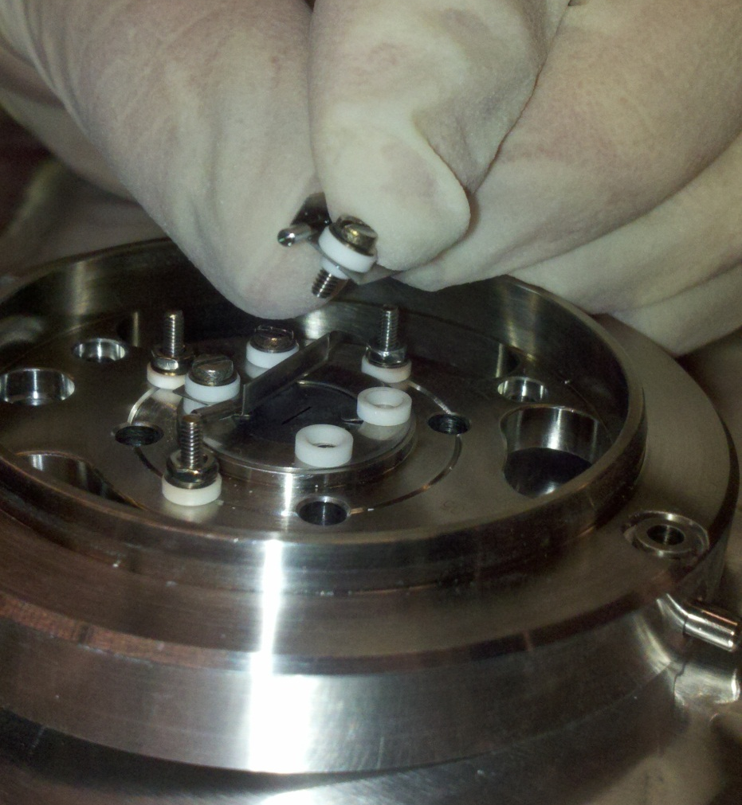
Prepare X-deflection plate screws
Screw
Washer
Ceramic feedthrough
X-deflection plate
Place over small ceramics – screw in
Take out temporary screws
Place 2 x-deflection ceramics over holes where x-deflection plate will be placed

Slide 7
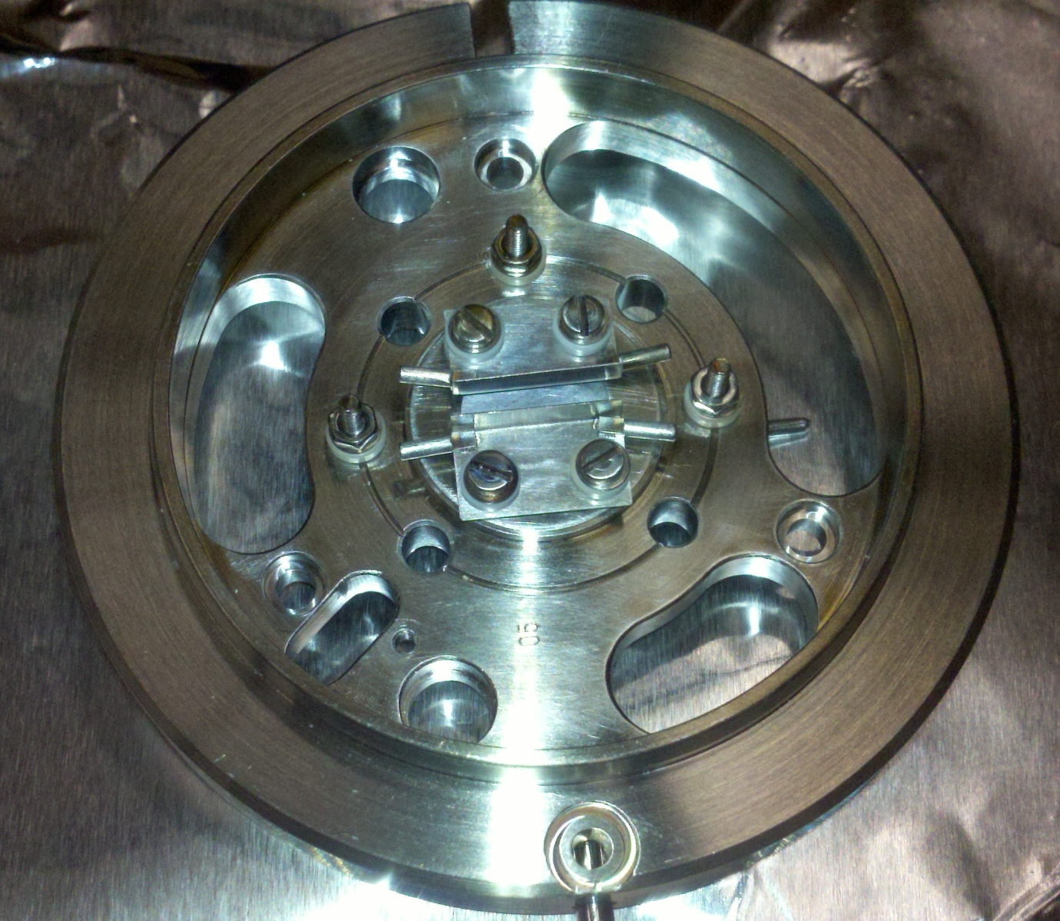
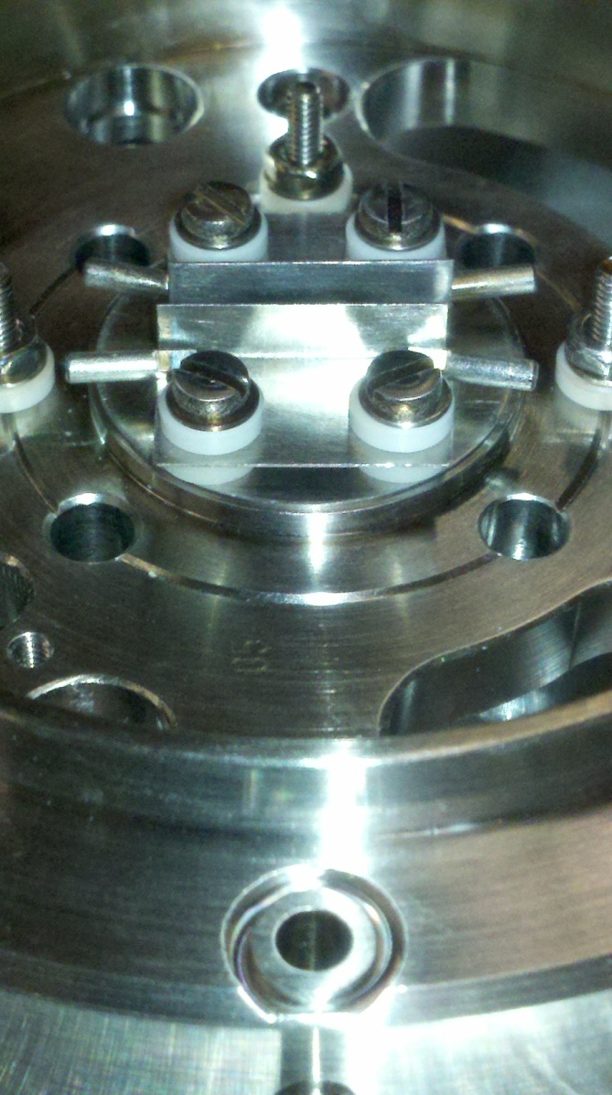
X-Deflection Plates Attached

Slide 8
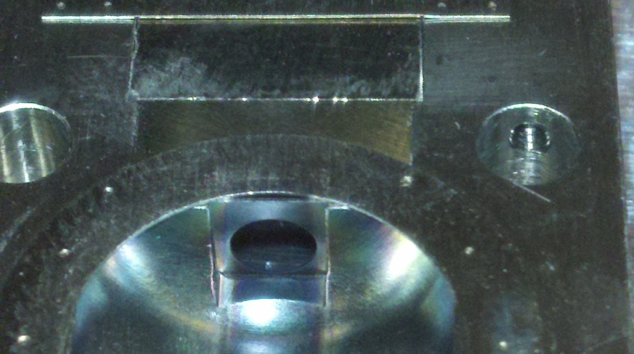
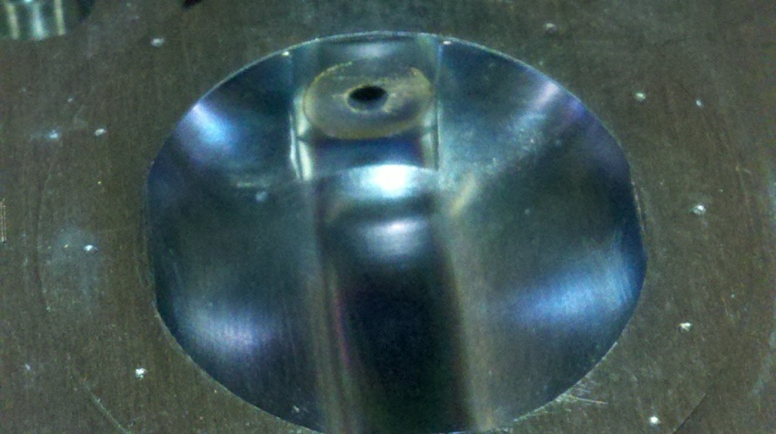
Within the ionization housing the filament has a smaller hole and the trap has a larger hole

Slide 9
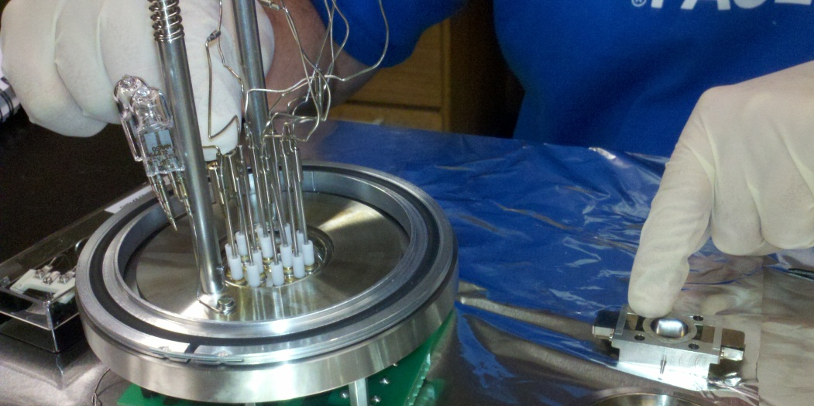
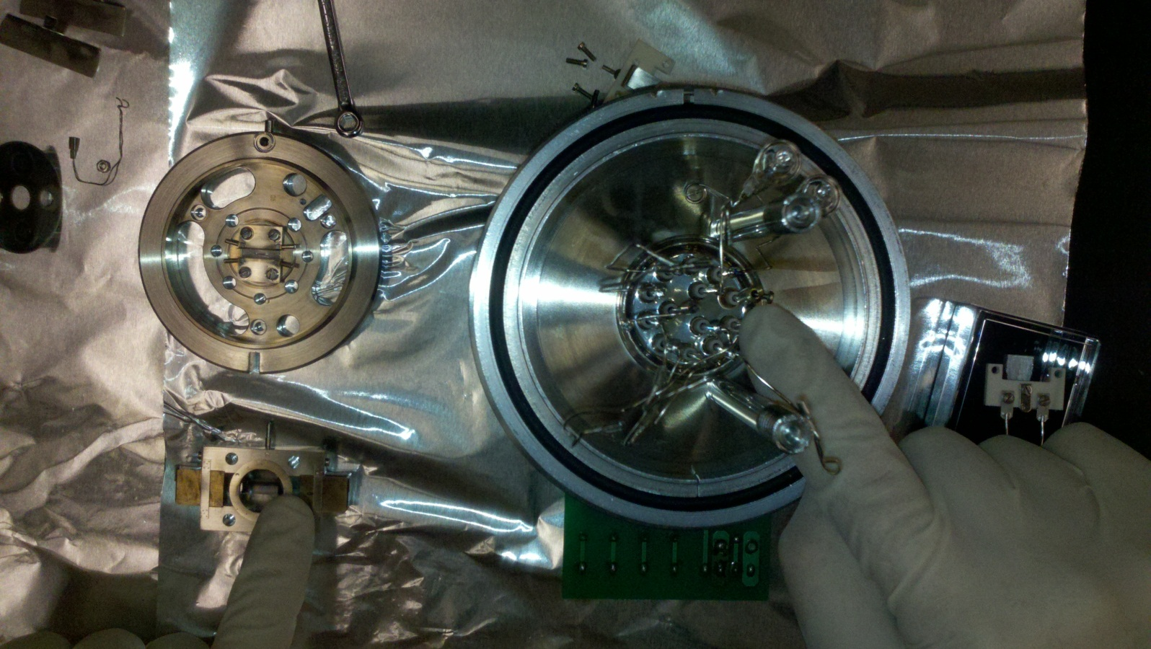
Orient ionization housing so that filament is aligned with the filament connectors.

Slide 10
Assembling The Stack
Put ceramic posts and springs into ionization housing
Secure rods into springs, rods should be parallel to trap and filament poles

Slide 11
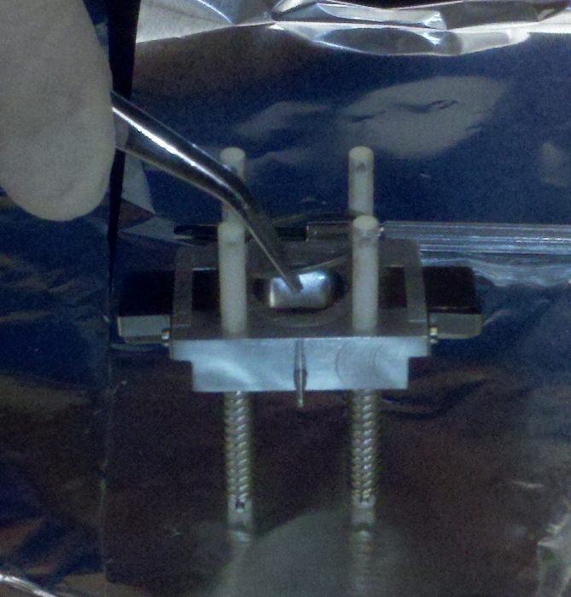
Place metal spacing ring on top of ionization housing
Put ion impeller (02) through ceramic posts and lay on top of metal spacing ring
Make sure that the slit in the ion impeller is lined up with the exit slit and the slit opening in the x-deflection plates
(Note: remaining pictures are missing feedthrough ceramics on x-plates; however, they DO belong there!)

Slide 12
Place ceramic spacer on top of ion impeller
Put extraction plates (03) through ceramic posts and lay on top of ceramic spacer
Make sure that the slit in the extraction plates are lined up and that the connecting posts are pointed towards the trap

Slide 13
Place small quartz spacer on top of extraction plates
Put x-focus plates (04) through ceramic posts and lay on top of quartz spacer
Make sure that the slit in the x-focus plates are lined up and that the connecting posts are pointed towards the trap

Slide 14
Place large quartz spacer on top of x-focus plates
The Stack is completed

Slide 15
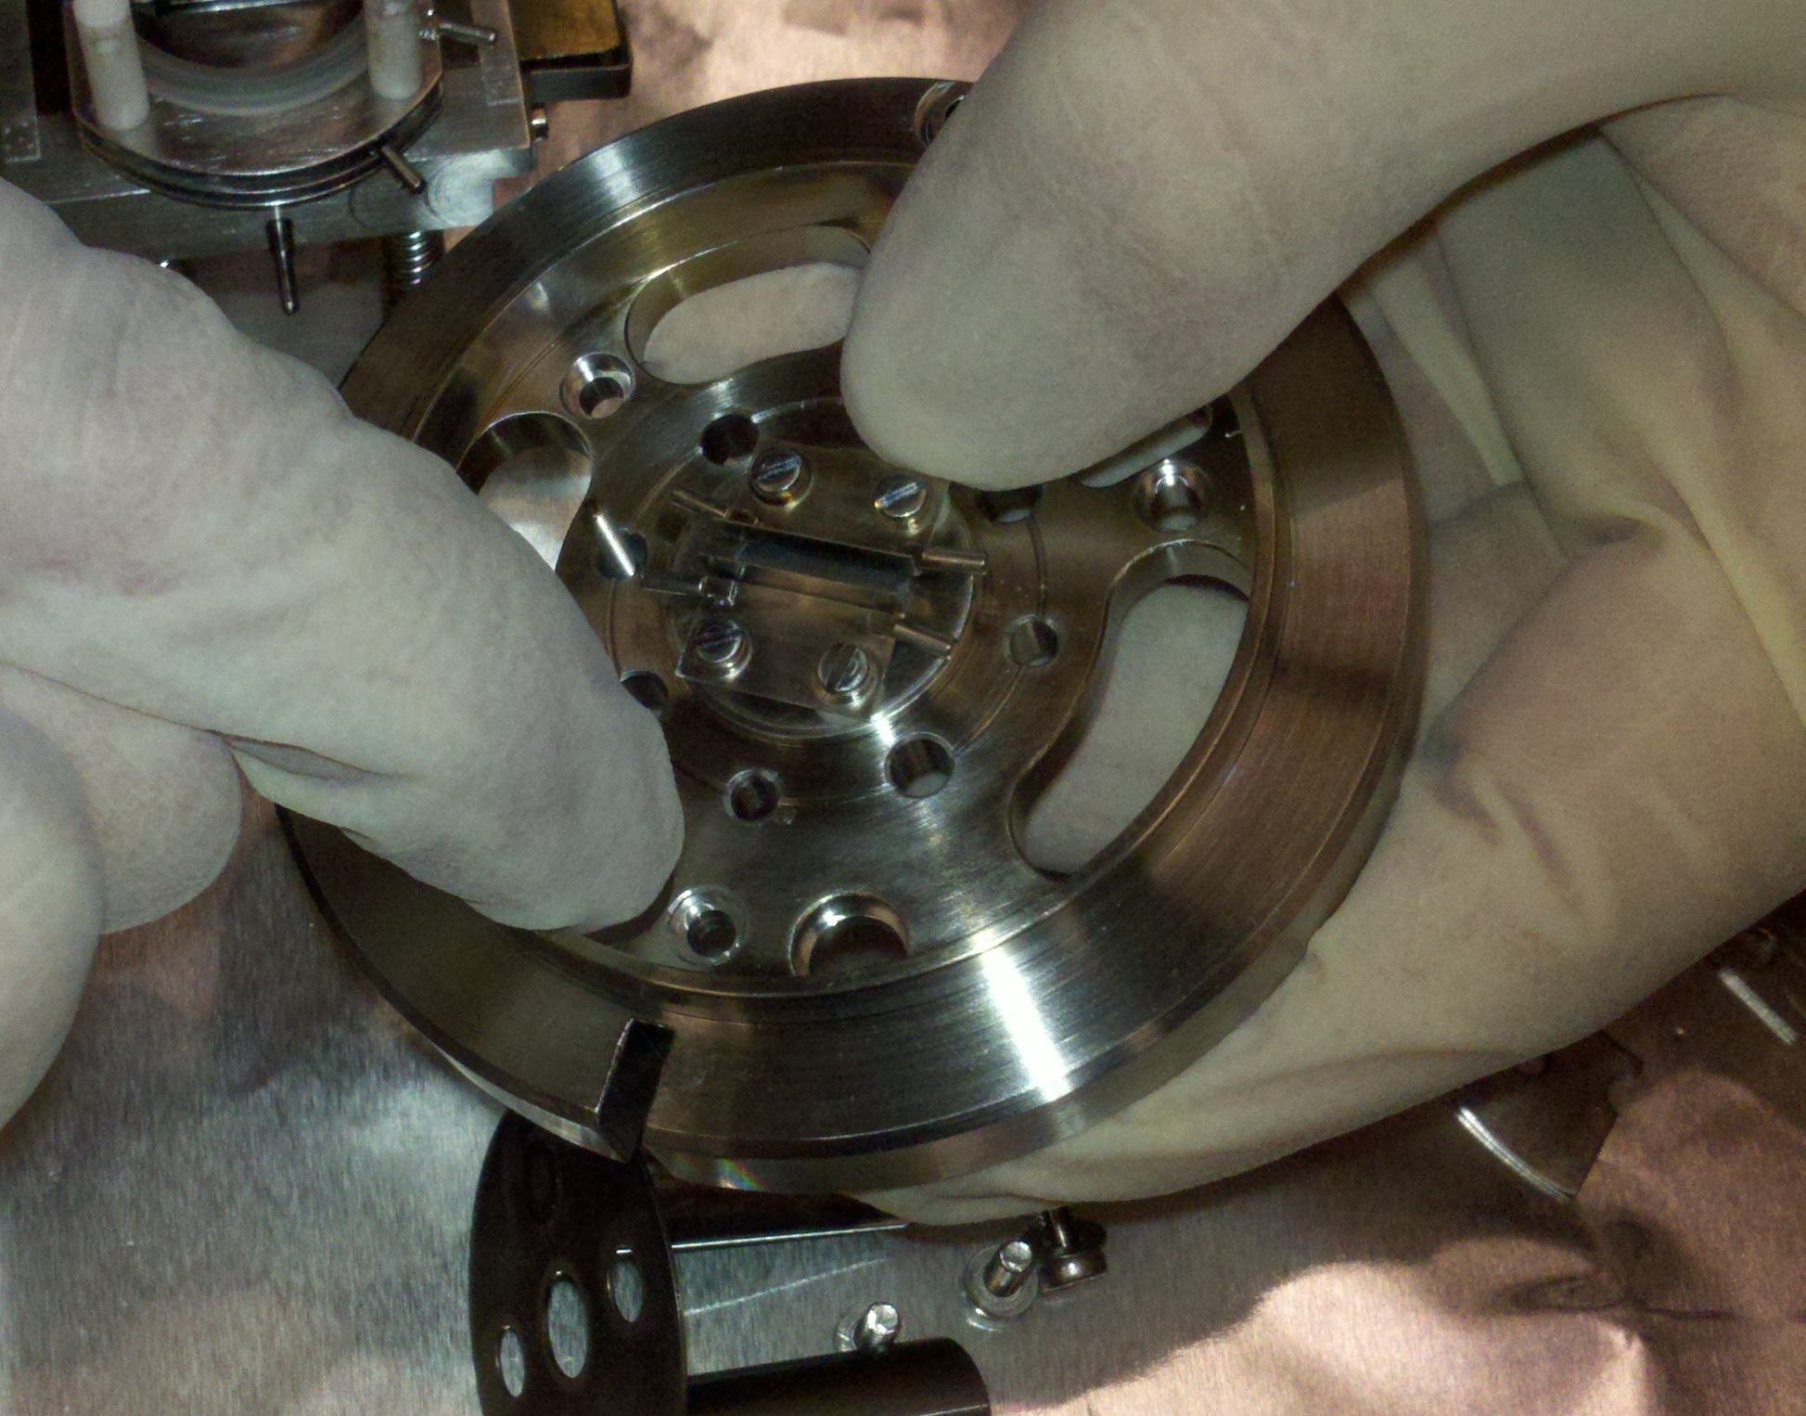
Feedthroughs
Posts

Slide 16
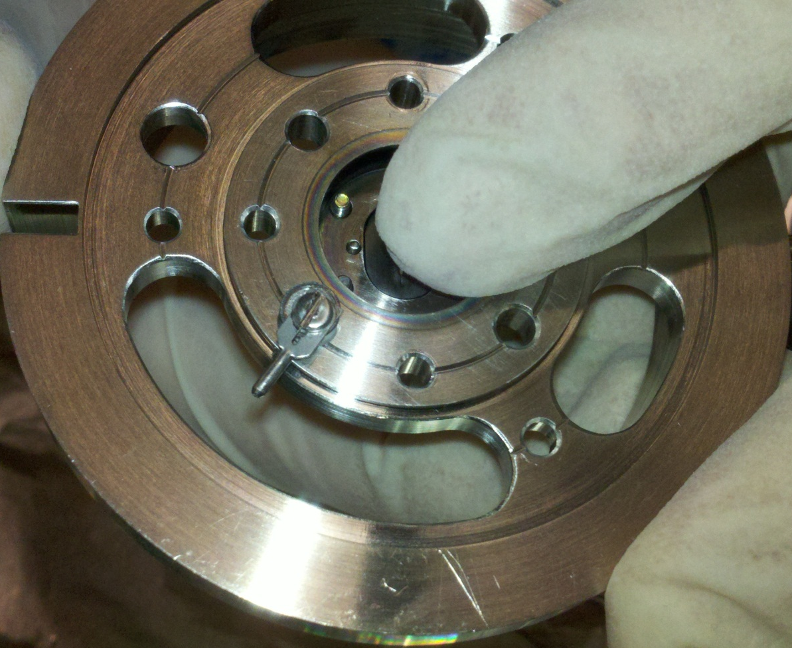
Put together screws
Current connecter
Big washer
Feedthrough ceramic
Put screw through small hole in base plate of ion source

Slide 17
On other side of feedthrough screw
Feedthrough ceramic
Small washer
Nut
Repeat for other 2 feedthroughs

Slide 18
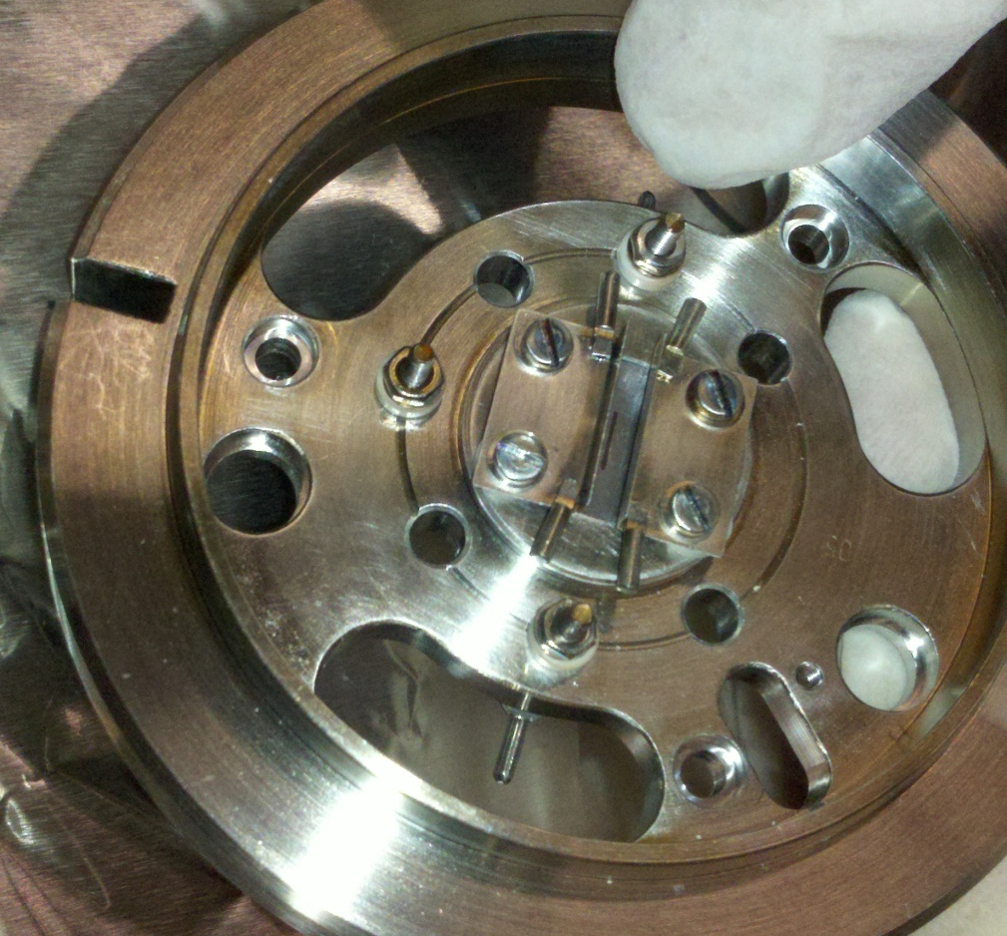
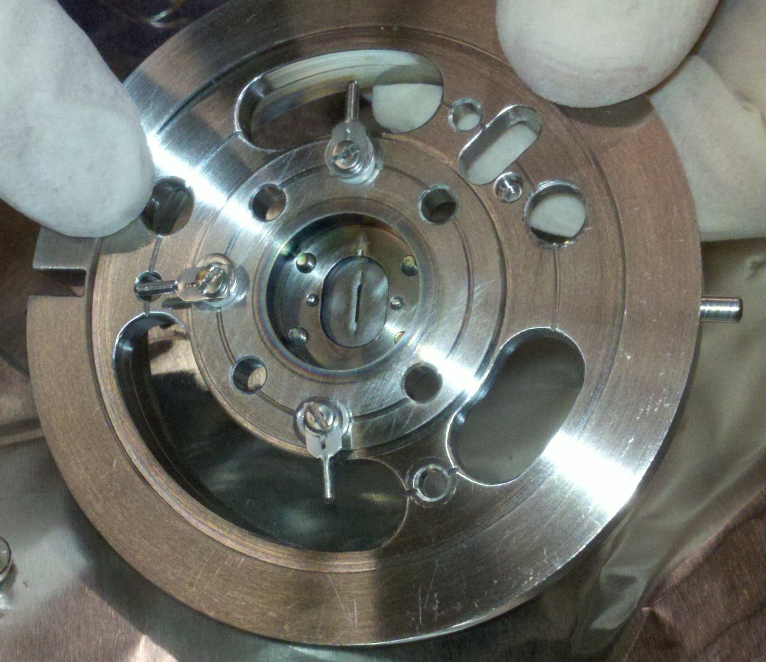
3 Feedthroughs attached!

Slide 19
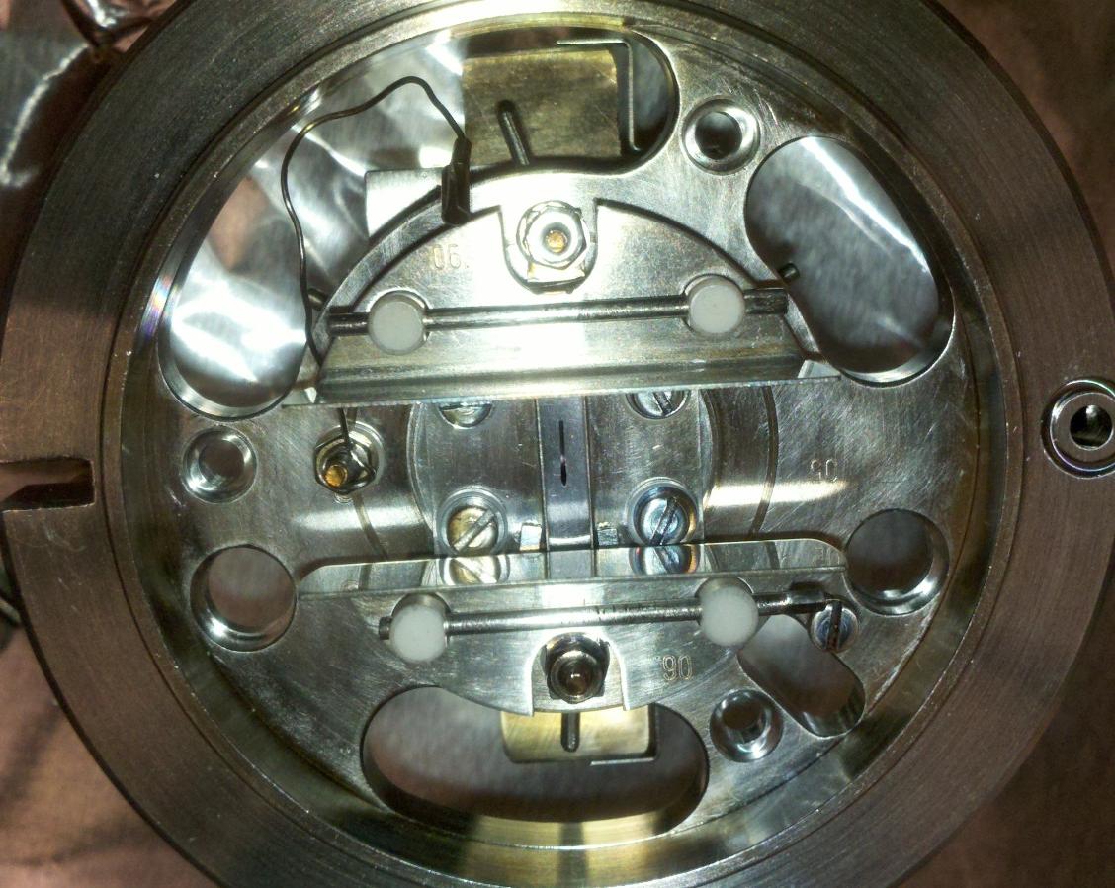
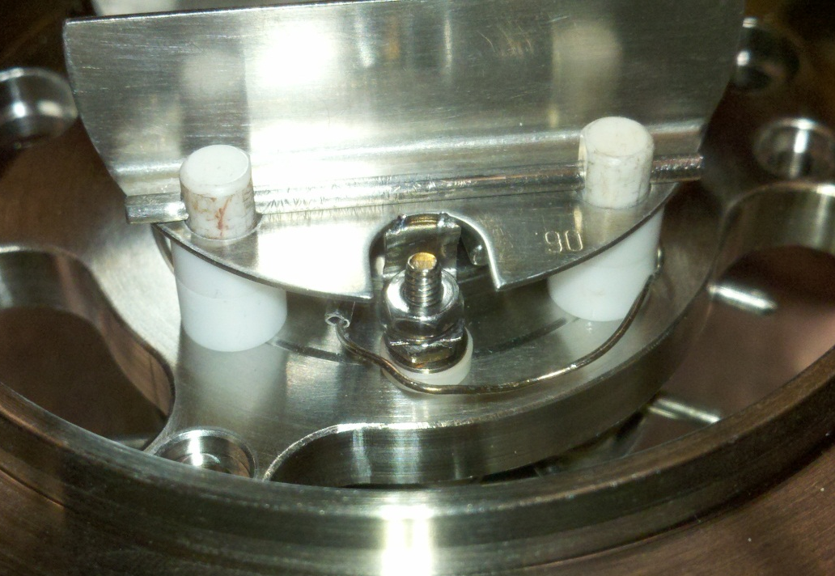
Connect X-grounding wire to feedthrough screw that is not aligned with exit slit
Grounding wire then nut
Attach X-grounding wire to X-deflection plate current connector

Slide 20
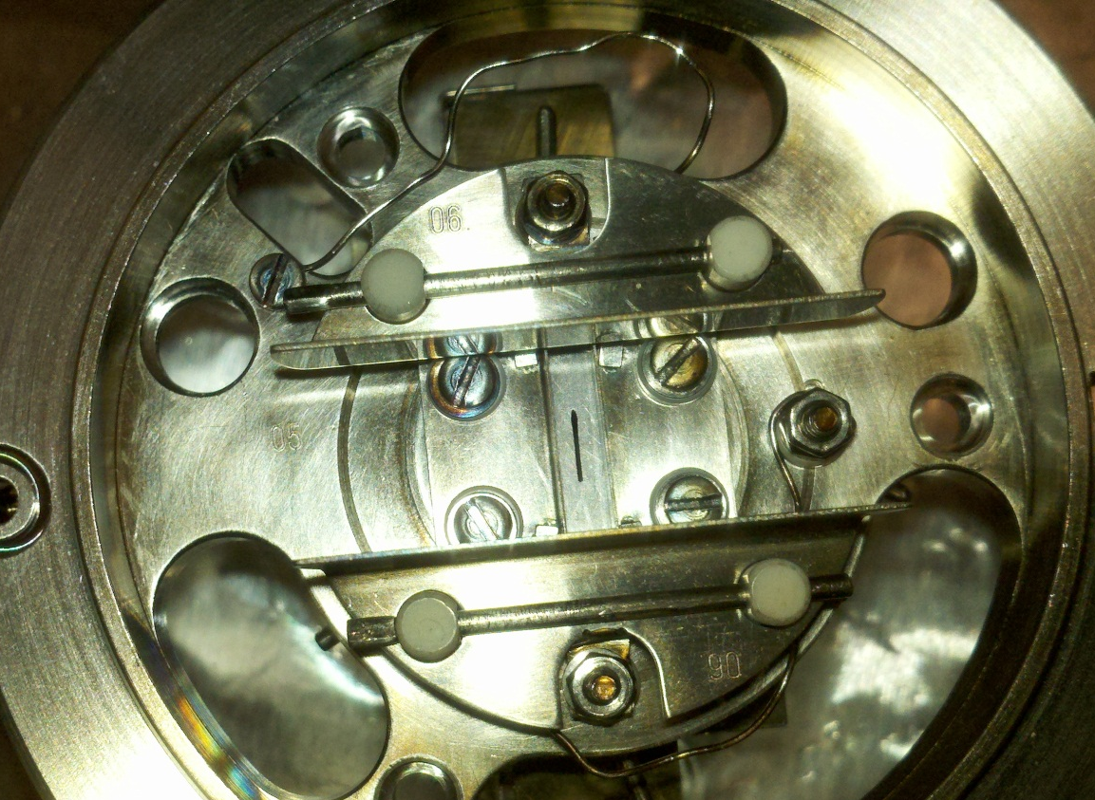
Connect other X-grounding wire to screw
Screw, washer, wire
Attach X-grounding wire to other X-deflection plate current connector
The 2 grounding wires should not be connected to the same plate!

Slide 21
Have y-deflection ceramic pieces and plates ready
To attach plates compress springs holding onto ion base
Put base plate of ion source on top of stack through ceramic posts

Slide 22
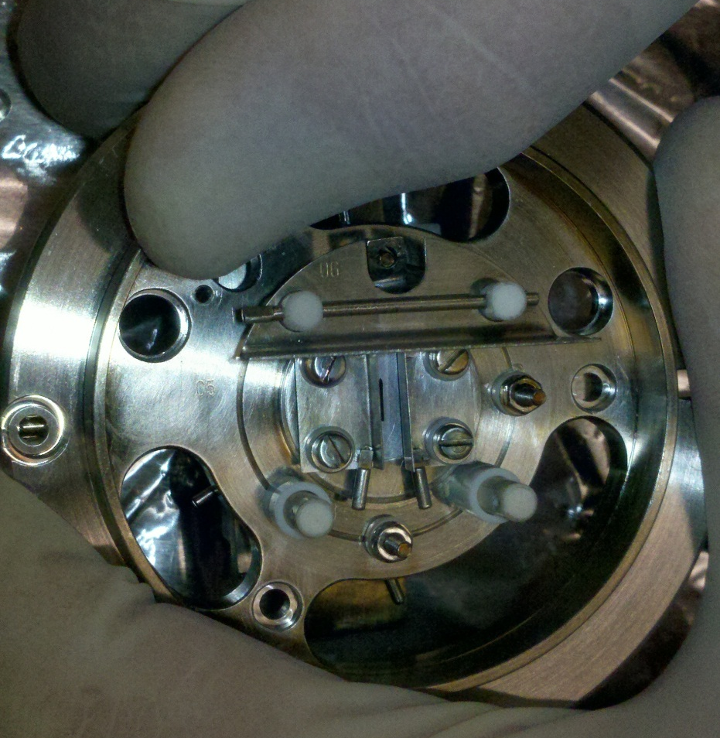
While compressing stack, place 2 ceramic pieces on each ceramic post (1 short, 1 tall)
Easiest way is to have one person compress stack and another put y-deflection plates on and secure with retention rod.
Place Y-deflection plate on top of ceramic pieces and on feedthrough screw.
Place retention rod through ceramic posts to secure plate
Screw plate down with nut on feedthrough screw

Slide 23
Y-Deflection Plates Attached

Slide 24
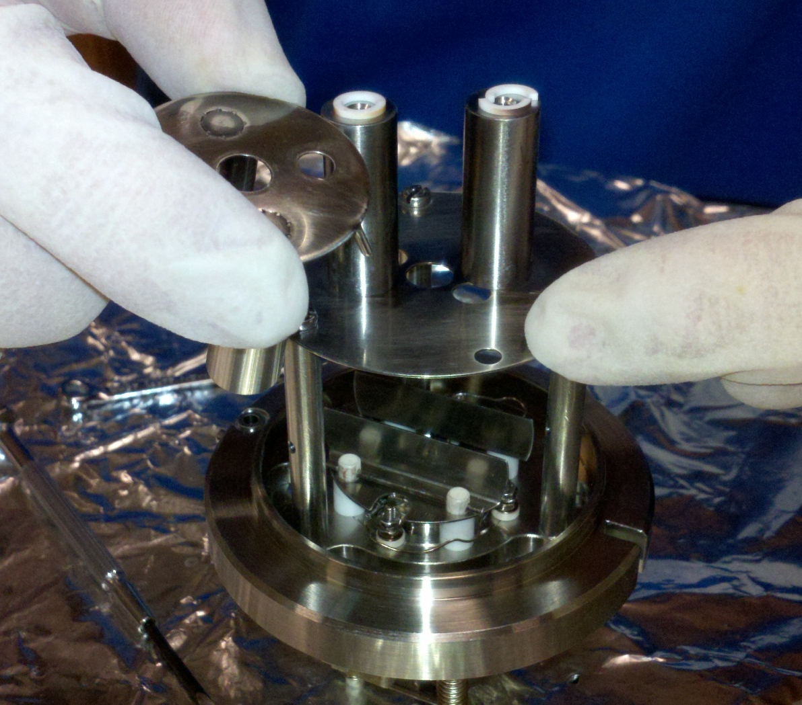
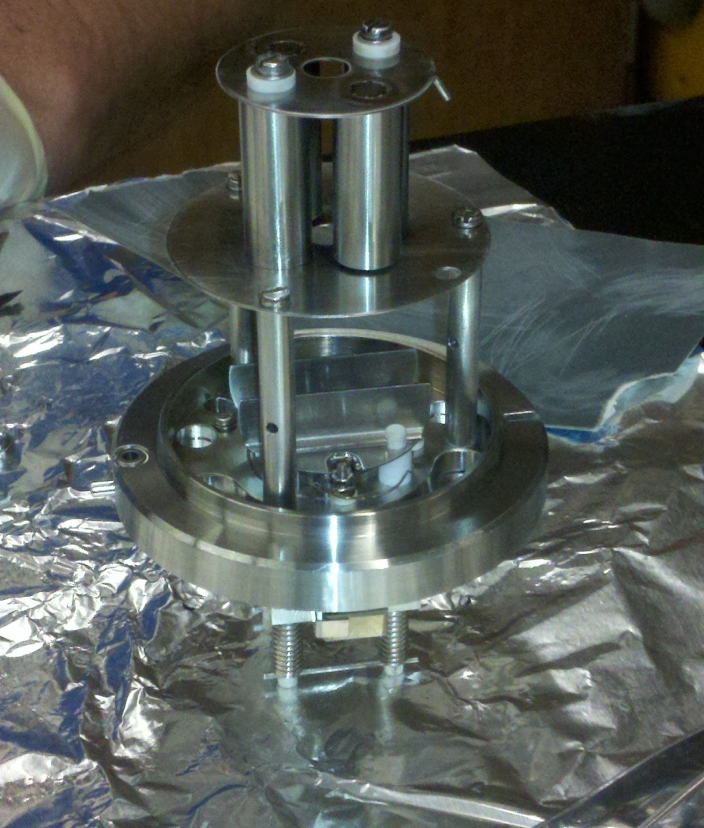
Assemble quadrupole and attach to base of ion source
Screw 3 metal rods into bottom of quadrupole
Place on top of the base to the ion source aligning the grounding wire hole with the connecting post of the top of the quadrupole
Attach top of quadrupole
Ceramic piece then screw

Slide 25
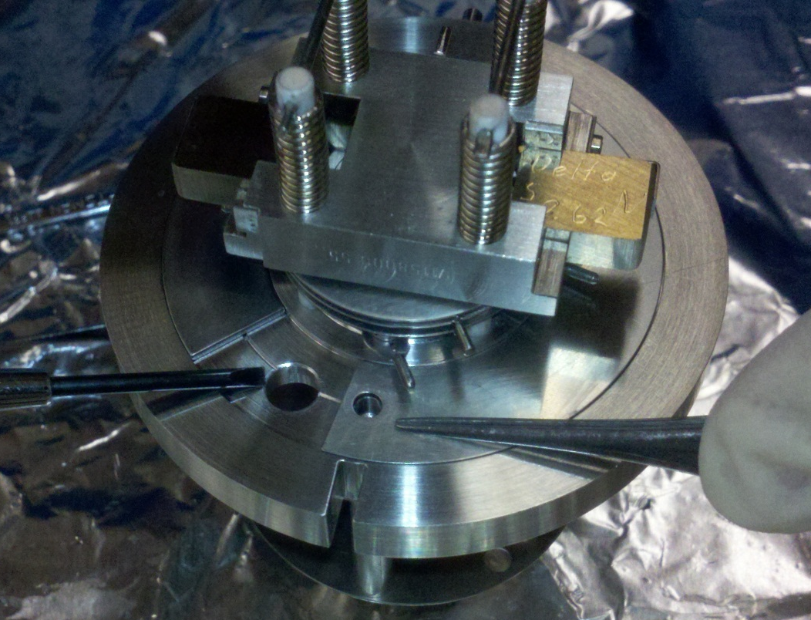
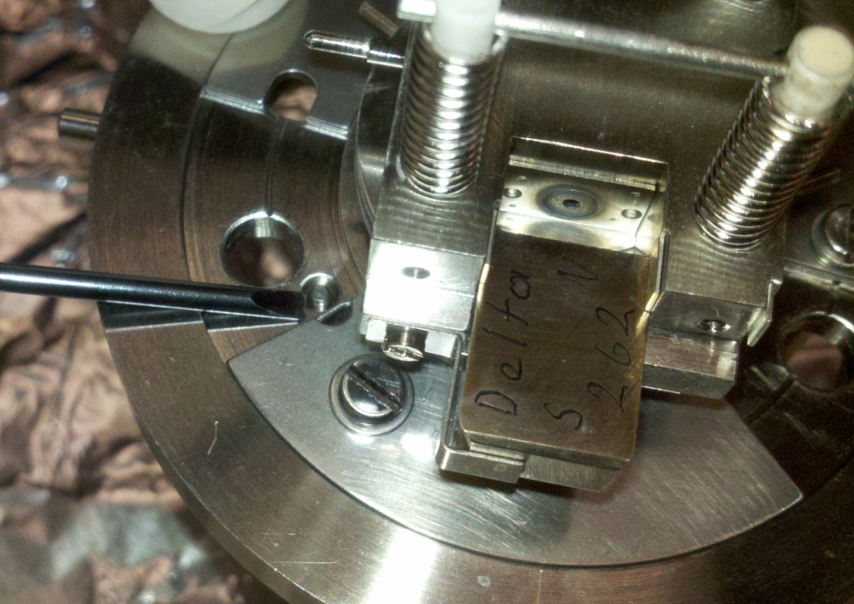
Attach quadrupole and ion source cover faceplates to the base of the ion source
Align ion source cover faceplates so that the holes are open (as seen in the above pictures)
Attach quadrupole through 3 holes and 3 posts
Washer then screw

Slide 26
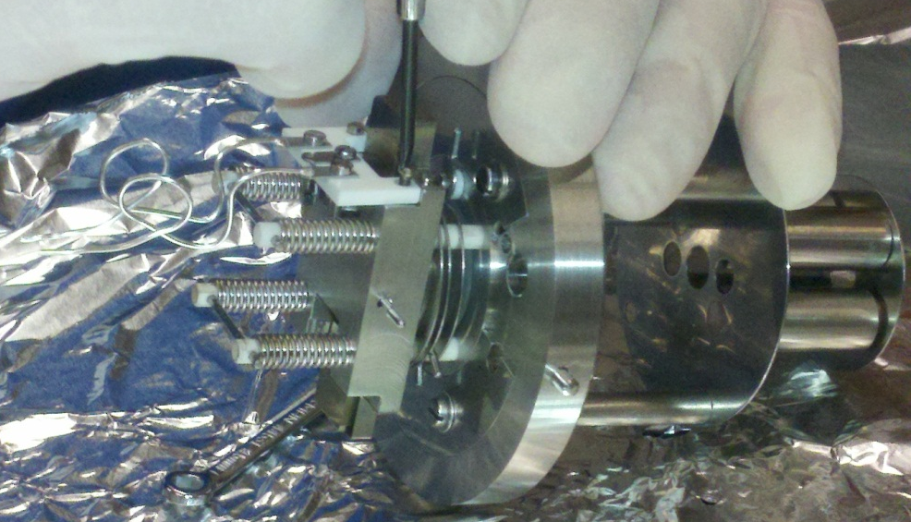
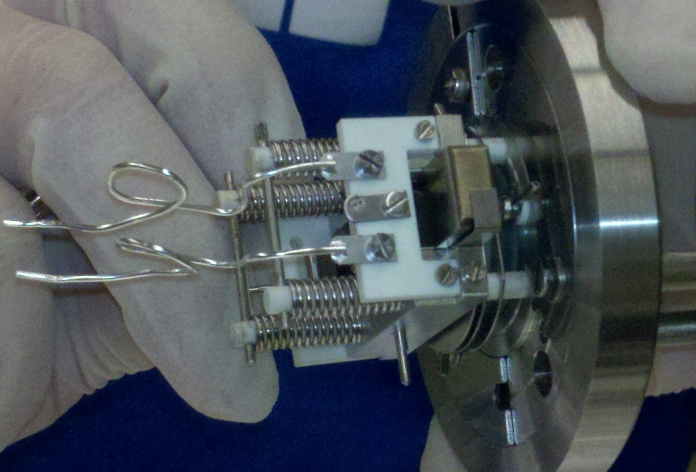
Attach filament
Screws only
Attach trap (not pictured)
Screws only

Slide 27
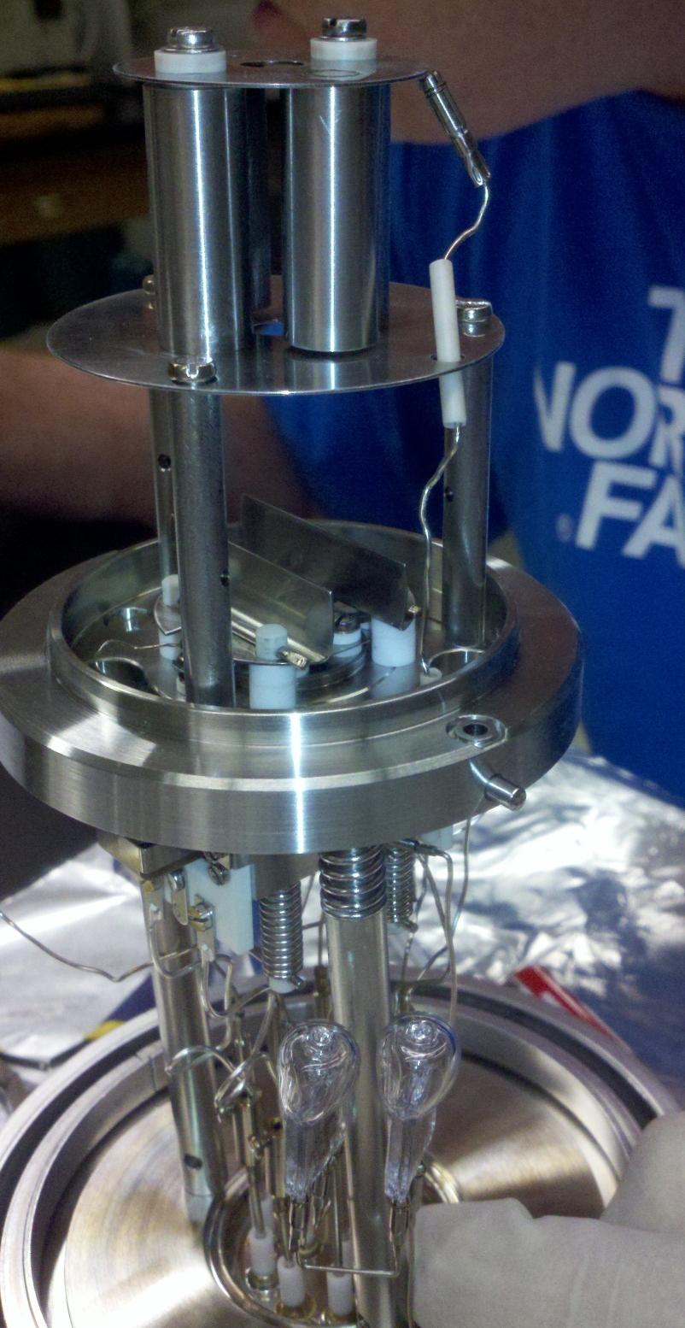
Attach base of ion source to ion source
Align base of ion source so that filament aligns with filaments connectors and so that holes for quadrupole go through to ion source
Tighten filament screws enough to make a connection
Connect quadrupole to ion source using ceramic connector (feed though base and quadrupole)

Slide 28
Attach remaining connectors to the connecting posts following the diagram:

